Slide 1
PARKK-IT
VEHICLE PARKING MANAGEMENT SYSTEM

Slide 2
GROUP MEMBERS
ICT/20/863 JEERASINGHE B.G.D.T.T.
ICT/20/839 FAAZATH Z.M.Z.M.F.
ICT/20/926 SANDEEPA S.A.D.
ICT/20/902 PRIYASALINY S.
ICT/20/837 DISSANAYAKE Y.N.S.

Slide 3
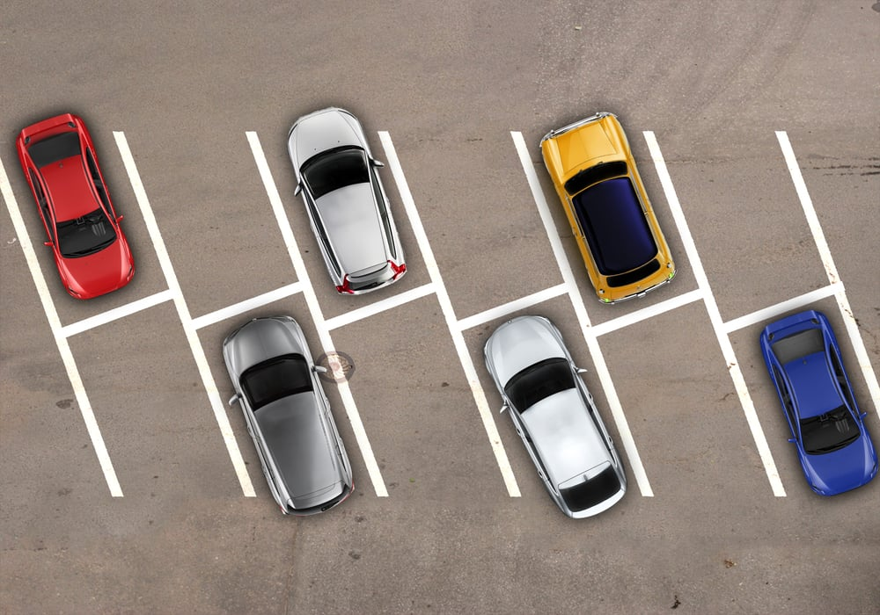
WHAT IS PARKK-IT ?

Slide 4
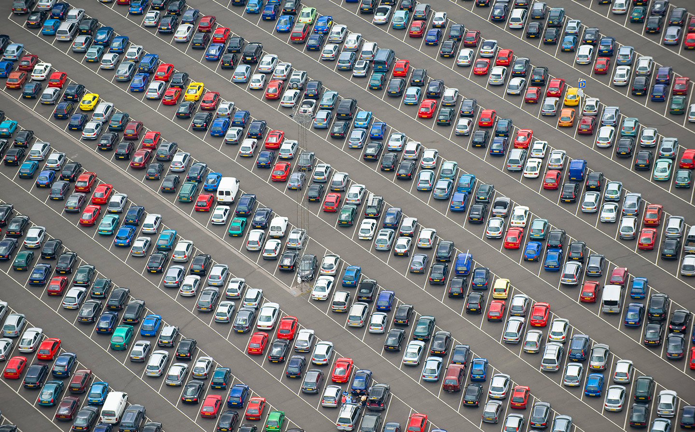
WHY PARKK-IT ?
Automate the processing of information involves in parking lot management.
The system will allow the parking lot administrator to electronically encode and store the records of parking slots availability, parking fees, parking duration, and customers and vehicles information.

Slide 5
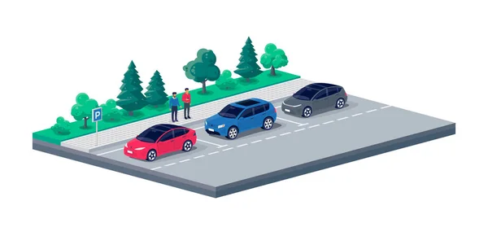
OBJECTIVES
Develop an automated system to electronically manage Vehicle Parking areas
Reduce manual workloads and paper works
Increase the operational efficiency
Improve overall customer satisfaction
Assess the system’s acceptability, efficacy, quality, timeliness, and productivity from the perspective of vehicle parking management

Slide 6
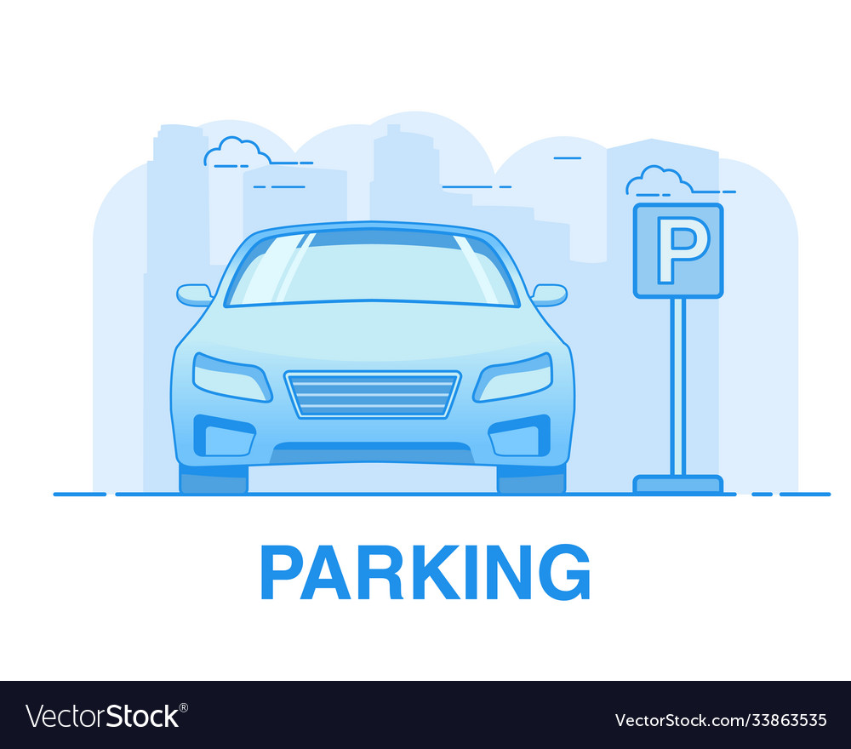
FUNCTIONAL REQUIREMENTS
Vehicle Entry and Exit Management
Parking Space Allocation
Payment Processing
Real-time Space Availability
Parking Duration Management

Slide 7
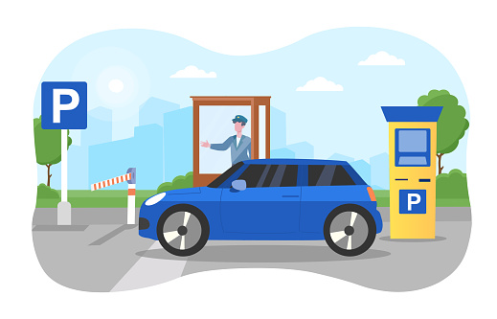
NON-FUNCTIONAL REQUIREMENTS
Speed
Efficiency
Accuracy
Performance
Security
Reliability

Slide 8
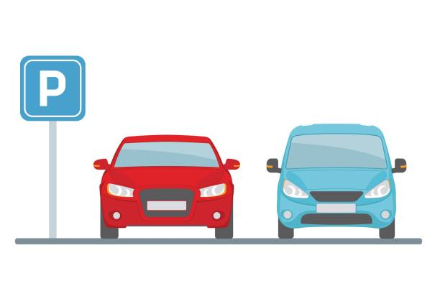
ADVANTAGES OF THE SYSTEM
Automated Transactions
Records Management
Report Generation

Slide 9



TOOLS & TECHNOLOGIES

Slide 10
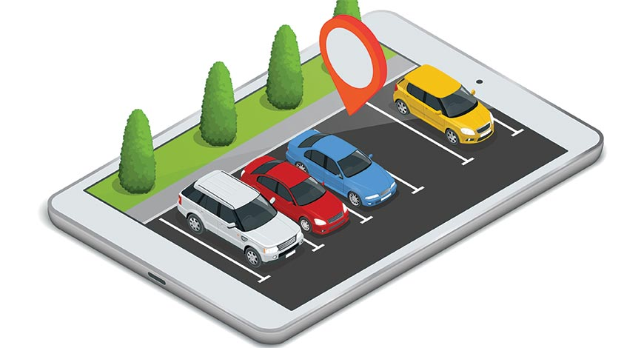
TIMELINE
WEEK 1
Project planning & Proposal
WEEK 6
Submit the final project
WEEK 5
Final testing & Complete the SRS document
WEEK 2
Designing the project
WEEK 3
Create Login page & Home page
WEEK 4
Create vehicle adding & managing page

Slide 11
Q & A

Slide 12
THANK YOU

